Slide 1
Extending Utah Energy Balance Snowmelt Model to Glacial Melt Calculations in HIMALA project
David Tarboton
Avirup Sen Gupta
Utah State University
http://www.engineering.usu.edu/dtarb dtarb@usu.edu

Slide 2
Overview
Adapting UEB Model for HIMALA
Process representations
Input/Output refactoring
Langtang Khola Example

Slide 3
Challenges for Himala
Extending UEB to glaciers
Process physics
Melt from debris covered glaciers
Albedo and substrate as an input
Interfaces (input and output file formats)
Coordination of UEB output with BASINS and GeoSFM

Slide 4
Utah Energy Balance Model Overview
Physically based calculation of snow energy balance.
Predictive capability in changed settings
Strives to get sensitivities to changes right
Simplicity. Small number of state variables and adjustable parameters.
Avoid assumptions and parameterizations that make no difference
Transportable. Applicable with little calibration at different locations.
Match diurnal cycle of melt outflow rates
Match overall accumulation and ablation for water balance.
Distributed by application over a spatial grid.
Effects of vegetation on interception, radiation, wind fields

Slide 5
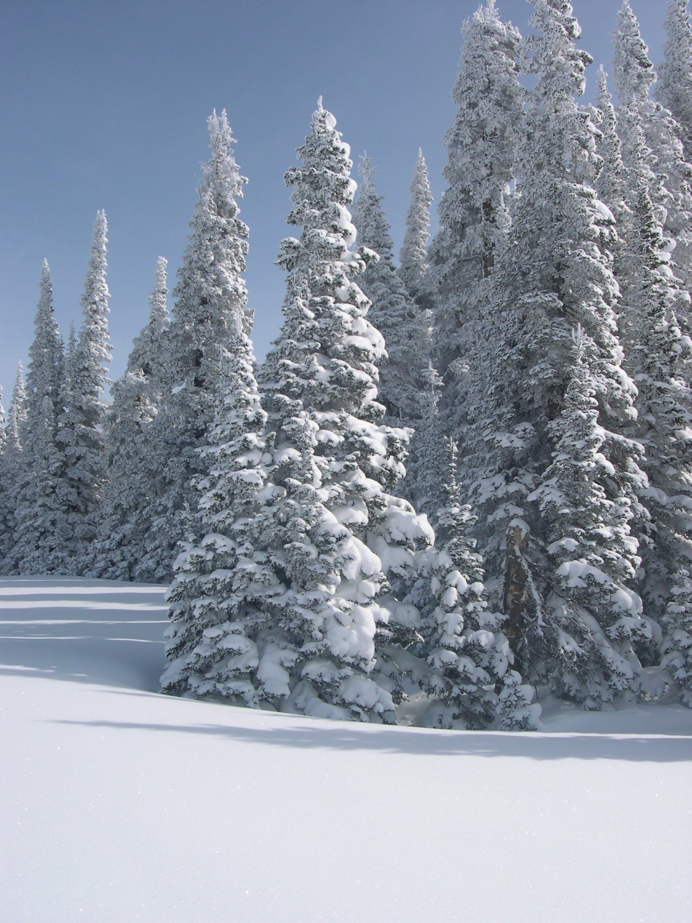
Processes in the Utah Energy Balance Snowmelt Model at a point
Above Canopy Inputs
Q_{si} e_{a} T_{a} Precip Wind
Fluxes dependent on Canopy temperature
Q_{hc}(T_{a},T_{c}) Q_{ec}(e_{a},T_{c}) Q_{lec}(T_{c})
Q_{sib} Q_{sid} Q_{li ,} Q_{p,}
Canopy Variable
Water Equivalent W_{c}
Leaf Area Index LAI
Direct radiance transmittance τ_{b}
Diffuse radiance transmittance τ_{d}
Fluxes dependent on
surface temperature
Q_{hs}(T_{a},T_{s}) Q_{es}(e_{a},T_{s}) Q_{les}(T_{s})
Q_{lec} (T_{c})
τ_{b}Q_{sib} τ_{d}Q_{sid} τ_{d} Q_{li} Q_{ps}
Energy Content Us
Water Equivalent Ws
Q
Snow
Thermally active ground layer
D_{e}
Soil
David Tarboton: http://www.engineering.usu.edu/dtarb
Q_{g}
Q_{m}

Slide 6
UEB Model Structure
State Variables
Surface snow water equivalent, W_{s}
Internal energy of the surface snowpack, U_{s}
Canopy snow water equivalent, W_{c}
State Equations
Surface mass and energy balance (beneath the canopy)
Canopy mass and energy balance
Notes:
Enhanced UEB model is also a parsimonious model
It has only three state variables namely, ………. and has two layers.
Rate of change of internal energy of snow is

Slide 7
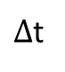
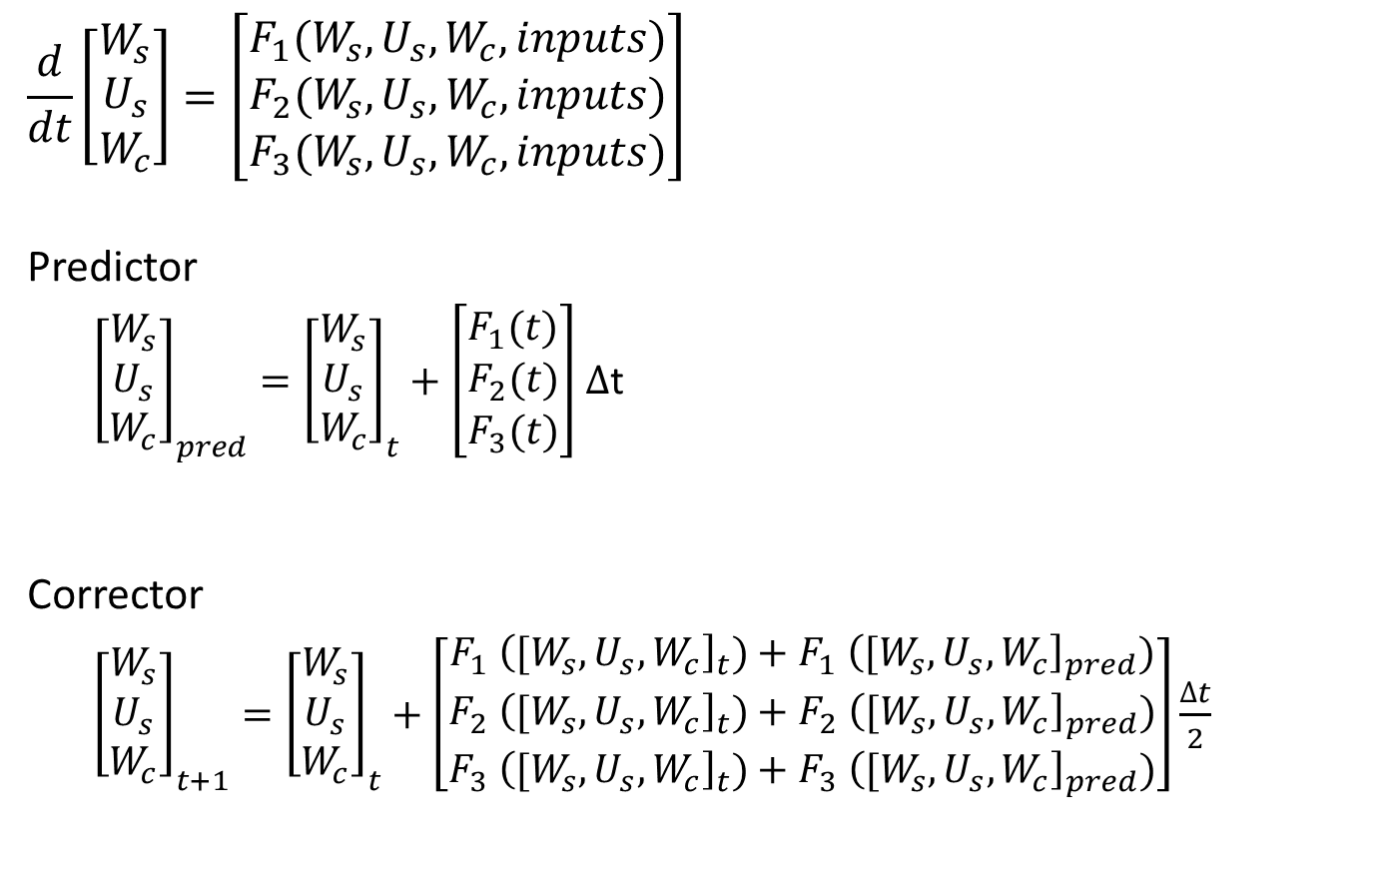
Numerical Approach
$$\frac{d}{dt}\left[\begin{matrix}W_{s} \\ U_{s} \\ W_{c}\end{matrix}\right]=\left[\begin{matrix}F_{1}(W_{s}, U_{s}, W_{c}, inputs) \\ F_{2}(W_{s}, U_{s}, W_{c}, inputs) \\ F_{3}(W_{s}, U_{s}, W_{c}, inputs)\end{matrix}\right]$$
Predictor
${\left[\begin{matrix}W_{s} \\ U_{s} \\ W_{c}\end{matrix}\right]}_{pred}={\left[\begin{matrix}W_{s} \\ U_{s} \\ W_{c}\end{matrix}\right]}_{t}+\left[\begin{matrix}F_{1}(t) \\ F_{2}(t) \\ F_{3}(t)\end{matrix}\right]$ $∆$t
Corrector
${\left[\begin{matrix}W_{s} \\ U_{s} \\ W_{c}\end{matrix}\right]}_{t+1}={\left[\begin{matrix}W_{s} \\ U_{s} \\ W_{c}\end{matrix}\right]}_{t}+\left[\begin{matrix}F_{1}{ \left({[W}_{s}, U_{s}, W_{c}\right]}_{t})+F_{1}{ \left({[W}_{s}, U_{s}, W_{c}\right]}_{pred}) \\ F_{2}{ \left({[W}_{s}, U_{s}, W_{c}\right]}_{t})+F_{2}{ \left({[W}_{s}, U_{s}, W_{c}\right]}_{pred}) \\ F_{3}{ \left({[W}_{s}, U_{s}, W_{c}\right]}_{t})+F_{3}{ \left({[W}_{s}, U_{s}, W_{c}\right]}_{pred})\end{matrix}\right]\frac{∆t}{2}$
W
True
Corrector
Predictor
$∆$t
t

Slide 8
Focus on parameterizations of
Glacier ice melting - new
Snow surface temperature
[Refreezing at the surface]
Spatial variability - grid or [subgrid parameterization]
Vegetation

Slide 9
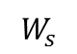
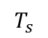
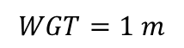
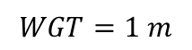
Glacier melt representation
Substrate type may be
0 bare ground (or vegetated)
1 clean glacier ice
2 dirty glacier ice
3 accumulation zone (model not run)
Albedo may optionally be a spatially and time varying input
Substrate albedo specified
$$T_{s}$$
Seasonal snow
$$W_{s}$$
Seasonal snow off
UEB Layer
$$WGT=1 m$$
$$WGT=1 m$$
Glacier ice
Seasonal Snow accumulation and melt
Glacier Ice Melting
Does not model glacier ice flow

Slide 10
Snow surface temperature
Heat diffusion into a semi-infinite medium with periodic (diurnal) boundary conditions
Solution
where, k = λ/Cρ
where, d = (2kω)^{1/2}
Modified Force-Restore (MFR)

Slide 11
Evaluation/Validation of SWE
Central Sierra Snow Lab (1986)
MFR
EQG

Slide 12
Evaluation/Validation of Internal Energy
Cache Valley, Utah, USA (1993)

Slide 13
Vegetation Component
To improve snowmelt modeling capability to account for the effects of forest canopy on the accumulation, sublimation and melting of snow
Canopy Radiation Transmission
Below and above canopy turbulent energy exchanges
Canopy Snow Interception
Bypassed when Leaf Area Index (LAI) is 0 as over glaciers and bare ground, but important in forested areas

Slide 14
Canopy Radiation Transmission
Q
f
Q
3
Partitioning accounting for
Vegetation transmittance (LAI)
Reflection, absorption, back scatter
Surface and vegetation albedo
Applied to both shortwave and longwave radiation (with different coefficients and longwave black body emissions)
Canopy
Q
f
Q
2
Q
f
Q
Surface
1
Shortwave (Solar) Radiation Fractions
Longwave Radiation Fractions
Mahat, V. and D. G. Tarboton, (2012), "Canopy radiation transmission for an energy balance snowmelt model," Water Resour. Res., 48: W01534, http://dx.doi.org/10.1029/2011WR010438.

Slide 15
Canopy Wind and Turbulent Fluxes Adaptation of two source land surface model for snow (Norman et al., 1995)
Norman, J. M., W. P. Kustas and K. S. Humes, (1995), "Source approach for estimating soil and vegetation energy fluxes in observations of directional radiometric surface temperature," Agricultural and Forest Meteorology, 77(3-4): 263-293, http://dx.doi.org/10.1016/0168-1923(95)02265-y.

Slide 16
Canopy Interception Processes
The rate of snow interception (m hr⁻¹)
The rate of snow mass unloading (m hr⁻¹)
Melt from the canopy (m hr⁻¹)
Sublimation of canopy snow (m hr⁻¹)
Notes:
The canopy snow interception processes algorithms we developed and added to the UEB model are
hf= latent heat of fusion

Slide 17
Validation/Evaluation of Vegetation Component
T.W. Daniel Experimental Forest, Logan, Utah, USA
Mahat, V. and D. G. Tarboton, (2012), "Canopy radiation transmission for an energy balance snowmelt model," Water Resour. Res., 48: W01534, http://dx.doi.org/10.1029/2011WR010438.
Notes:
This slide shows the modeled vs measured SWE for different vegetation for three years.
We are focusing on the melt period where effects of interception is less.
This result suggests that the model is able to capture the snowmelt rate that is sensitive to different forest type and leaf density.

Slide 18
UEB Grid Implementation
Model run separately at each active grid cell
Melt outputs aggregated for subwatersheds
Structured File based IO for linking with BASINS and GeoSFM
ASCII for non spatial data
NetCDF for geospatial data

Slide 19
Variable types
Spatially constant and constant in time (SCTC) such as model parameters.
Spatially constant but time varying (SCTV) such as an input quantity for which there is not information about spatial variability.
Spatially variable but constant in time (SVTC) such as slope, aspect and substrate type.
Spatially variable and variable in time (SVTV) such as air temperature and Precipitation that vary in time and space.

Slide 20
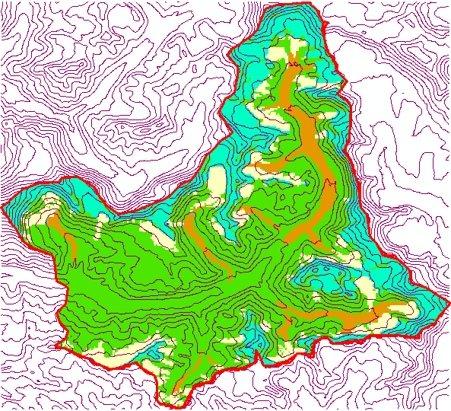
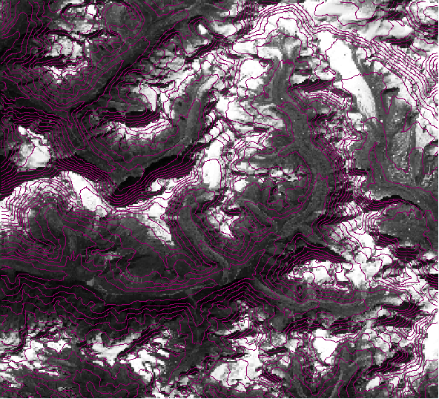
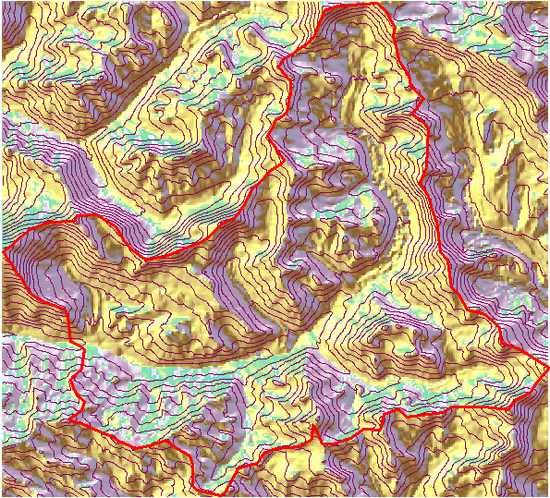
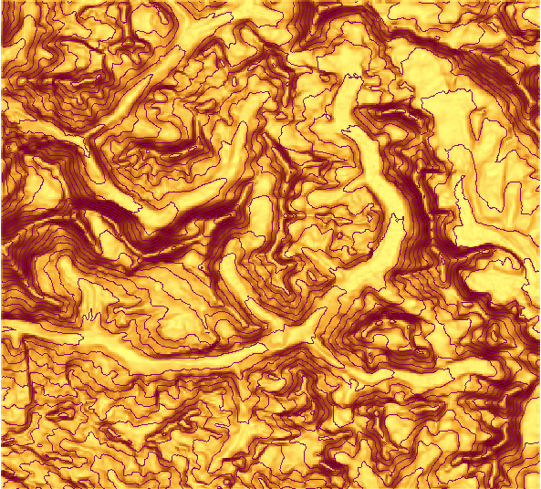
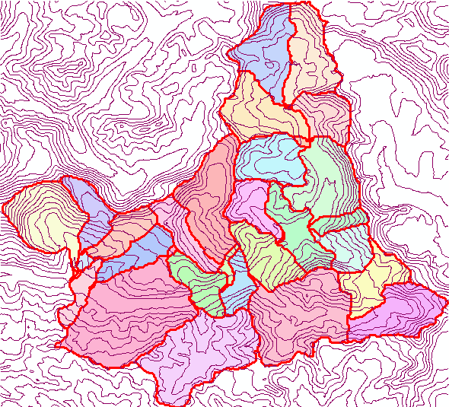
Spatially Variable Input Layers (SVTC)
Elevation
Substrate Type
Albedo
Aspect
Slope
Subwatersheds
Others ...

Slide 21
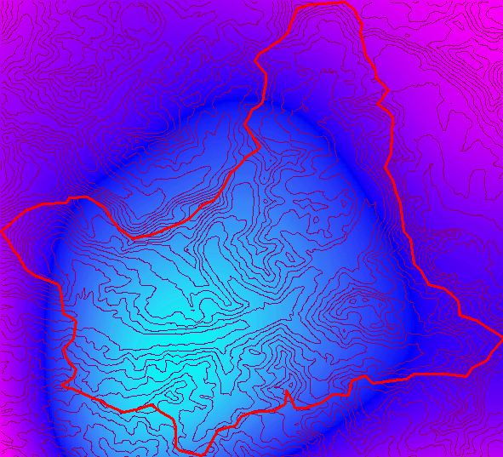
Space time inputs (SVTV)
Precipitation
Air temperature
Solar Radiation
etc.
As 3D NetCDF files
t
y
x

Slide 22
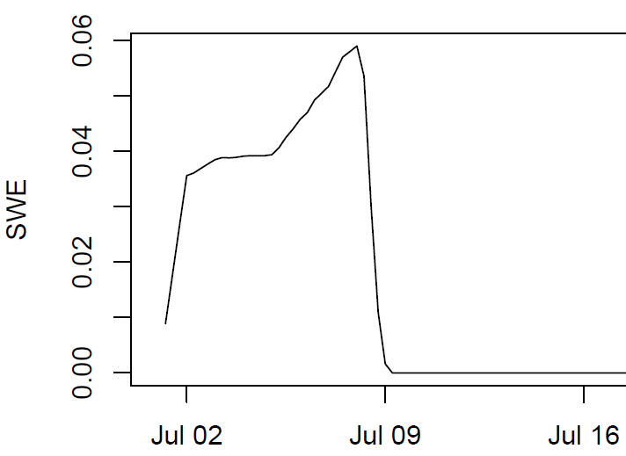
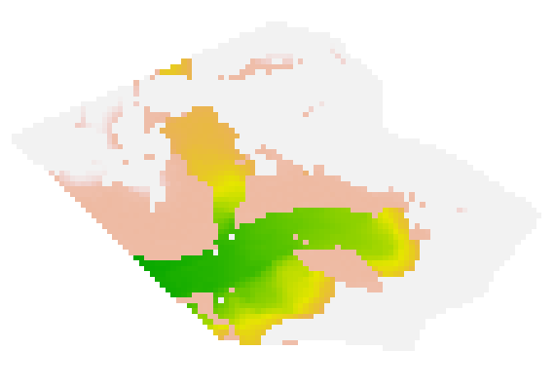
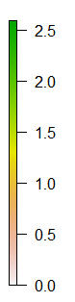
UEB Grid Implementation Model run through time for each active grid cell
Time Outputs
Spatial Outputs

Slide 23
File-Based Input-output system
Overall control file
Input Files
Output Files
Watershed file
Parameter file
Site Initial file
Input Control file
Output Control file
Provides site and initial condition values, or points to 2-D NetCDF files where these are spatially variable
Provides start, end and time step, and info. on time varying inputs as either from text file for domain, from 3-D NetCDF file where spatially variable, or constant for all time
Indicates which variables are to be output and the file names to write outputs.
Provides watershed ID for each grid from the NetCDF file
Provides parameter Values
Point detail text file
3-D NetCDF files
Aggregated Output Control
Holds all output variables for all time steps for a single grid point
Holds a single output variable for all time steps and for entire grid.
Holds list of variables for which aggregated output is required
2-D NetCDF files
Time series text file
3-D NetCDF files
Provides spatially variable site and initial condition values
provides input variables for each time step and assumes a constant value for all the grid points
Provides input variables for each time step and each grid point
Aggregated Output text file
Holds aggregated output

Slide 24
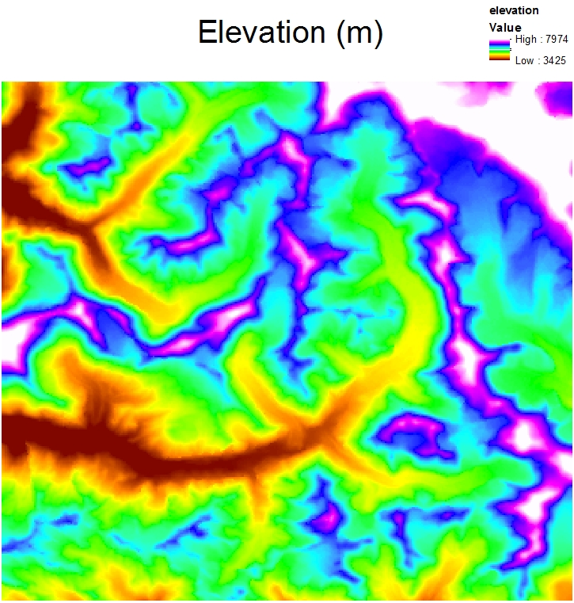
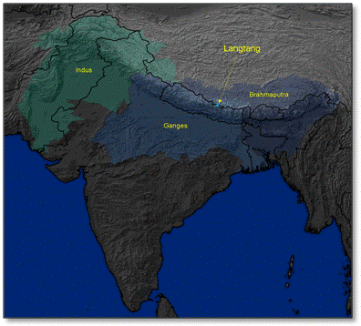
Preliminary Langtang Khola Results for evaluation/validation

Slide 25
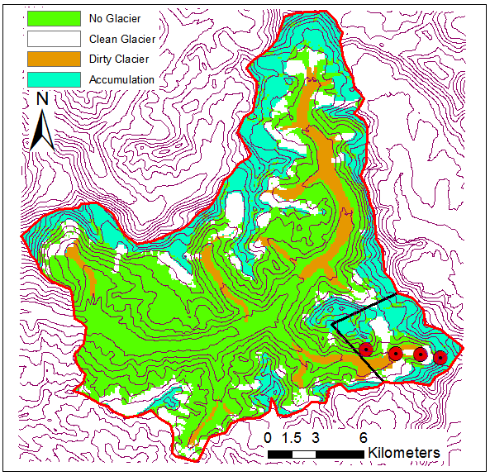
Substrate Type
Type of beneath snow substrate encoded as (0 = Ground/Non Glacier, 1=Clean Ice/glacier, 2= Debris covered ice/glacier, 3= Glacier snow accumulation zone)

Slide 26
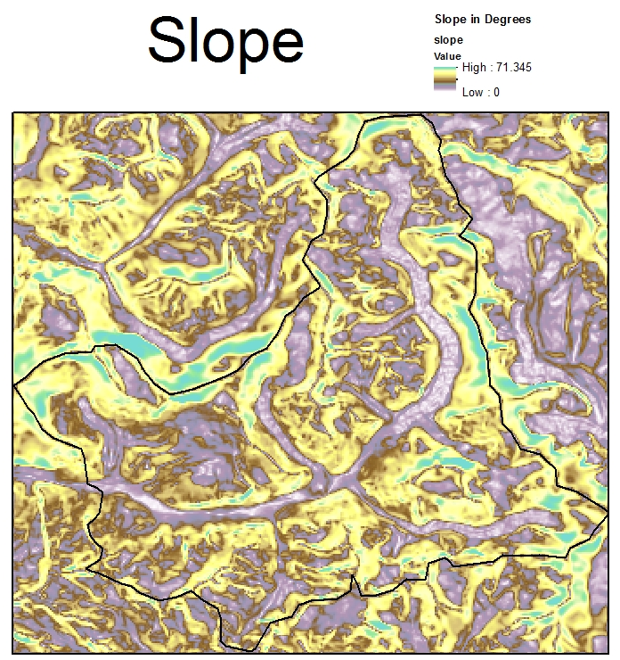

Slide 27
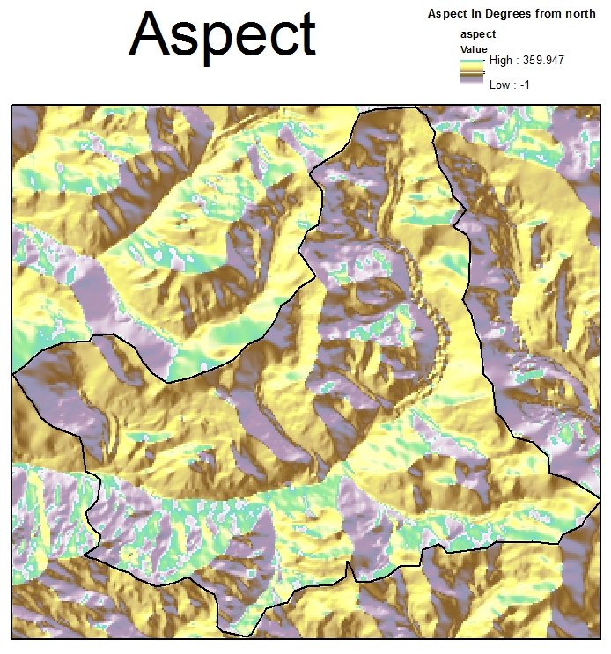

Slide 28
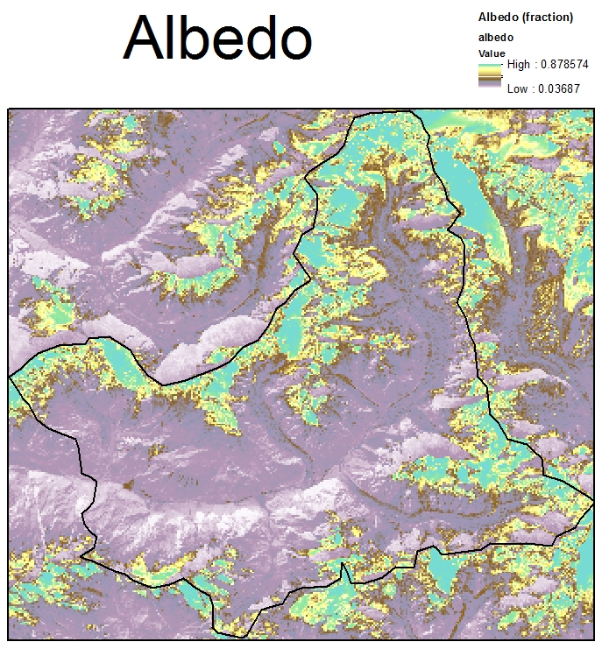
Substrate Albedo

Slide 29
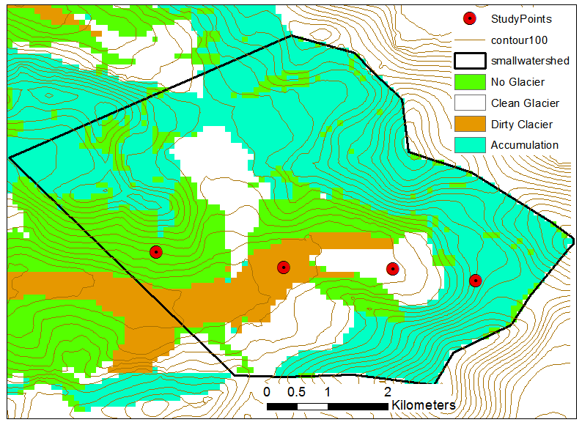
Examination of results at 4 points
D
C
B
A

Slide 30
Input Air Temperature
Input Air Temperature adjusted from measurement at the outlet using elevation and a lapse rate (6 C/km)
Concern over whether the jump is correct

Slide 31
Solar Radiation
Differences due to slope and aspect
Values greater than solar constant due to energy being modeled per unit horizontal area
A is west facing 45º
Slope area A_{s}
Q_{si} = I_{o} T_{f} A_{s}/A_{h}
Horizontal area A_{i}

Slide 32
Precipitation
Snow Fraction
Air Temperature C
Input Precipitation measured at outlet assumed the same everywhere

Slide 33
Snow Water Equivalent
This is seasonal snow above the glacier surface that accumulates due to modeled seasonal snowfall

Slide 34
Melt Outflow
This is total modeled outflow that includes snowmelt, rainfall when there is no seasonal snow and glacier melt

Slide 35
Total and Glacier Melt at B (Clean Glacier)

Slide 36
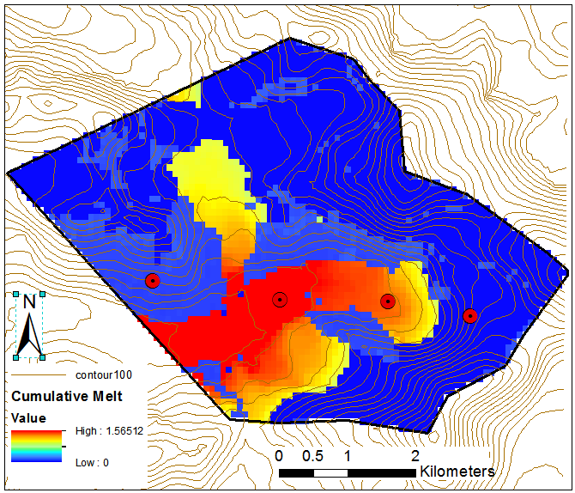
Cumulative Melt July 2001
Total melt including snowmelt, rainfall and glacier melt accumulated over the month of July 2001
Average 0.297 m
Complete Watershed (Langtang Khola) July 2001 flow is 11.6 m³/s corresponding to 0.47 m over glacier area or 0.088 m over full area

Slide 37
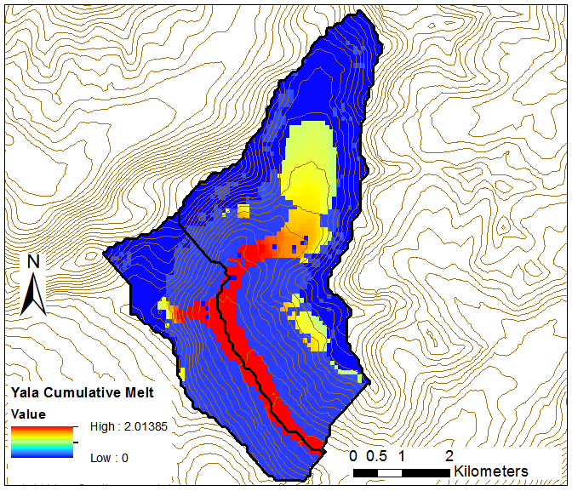
Yala Cumulative Melt
Total melt including snowmelt, rainfall and glacier melt accumulated over the month of July 2001
Average 0.31 m
Complete Watershed (Langtang Khola) July 2001 flow is 11.6 m³/s corresponding to 0.47 m over glacier area or 0.088 m over full area

Slide 38
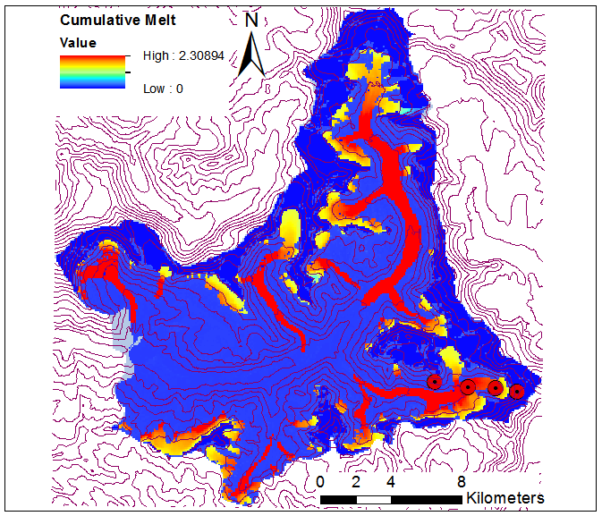
Langtang Khola Cumulative Melt
Total melt including snowmelt, rainfall and glacier melt accumulated over the month of July 2001
Average 0.287 m
Complete Watershed (Langtang Khola) July 2001 flow is 11.6 m³/s corresponding to 0.47 m over glacier area or 0.088 m over full area

Slide 39
Steps in ongoing work
Vectorize input and output to improve efficiency
Validation, evaluation and sensitivity analysis
Run using NASA Modern Era-retrospective Analysis for Research and Application (MERRA) downscaled data
Run over other watersheds comparing to streamflow measurements
Run in the BASINS framework to evaluate/validate integration

Slide 40
Collaborations
ICIMOD, Kathmandu University, Aquaterra (others)
ICIMOD
help with local data for evaluation
help with facilitating applicability
Kathmandu University
glacier melt mechanisms and glacier processes
Local data and knowledge
Aquaterra
BASINS integration

Slide 41
Summary/Conclusions
UEBGrid is ready for integration with BASINS
Issues that arise will need to be addressed
UEBGrid is producing glacier melt outputs that need evaluation and examination
to validate model functioning
to validate input data

